Slide 1
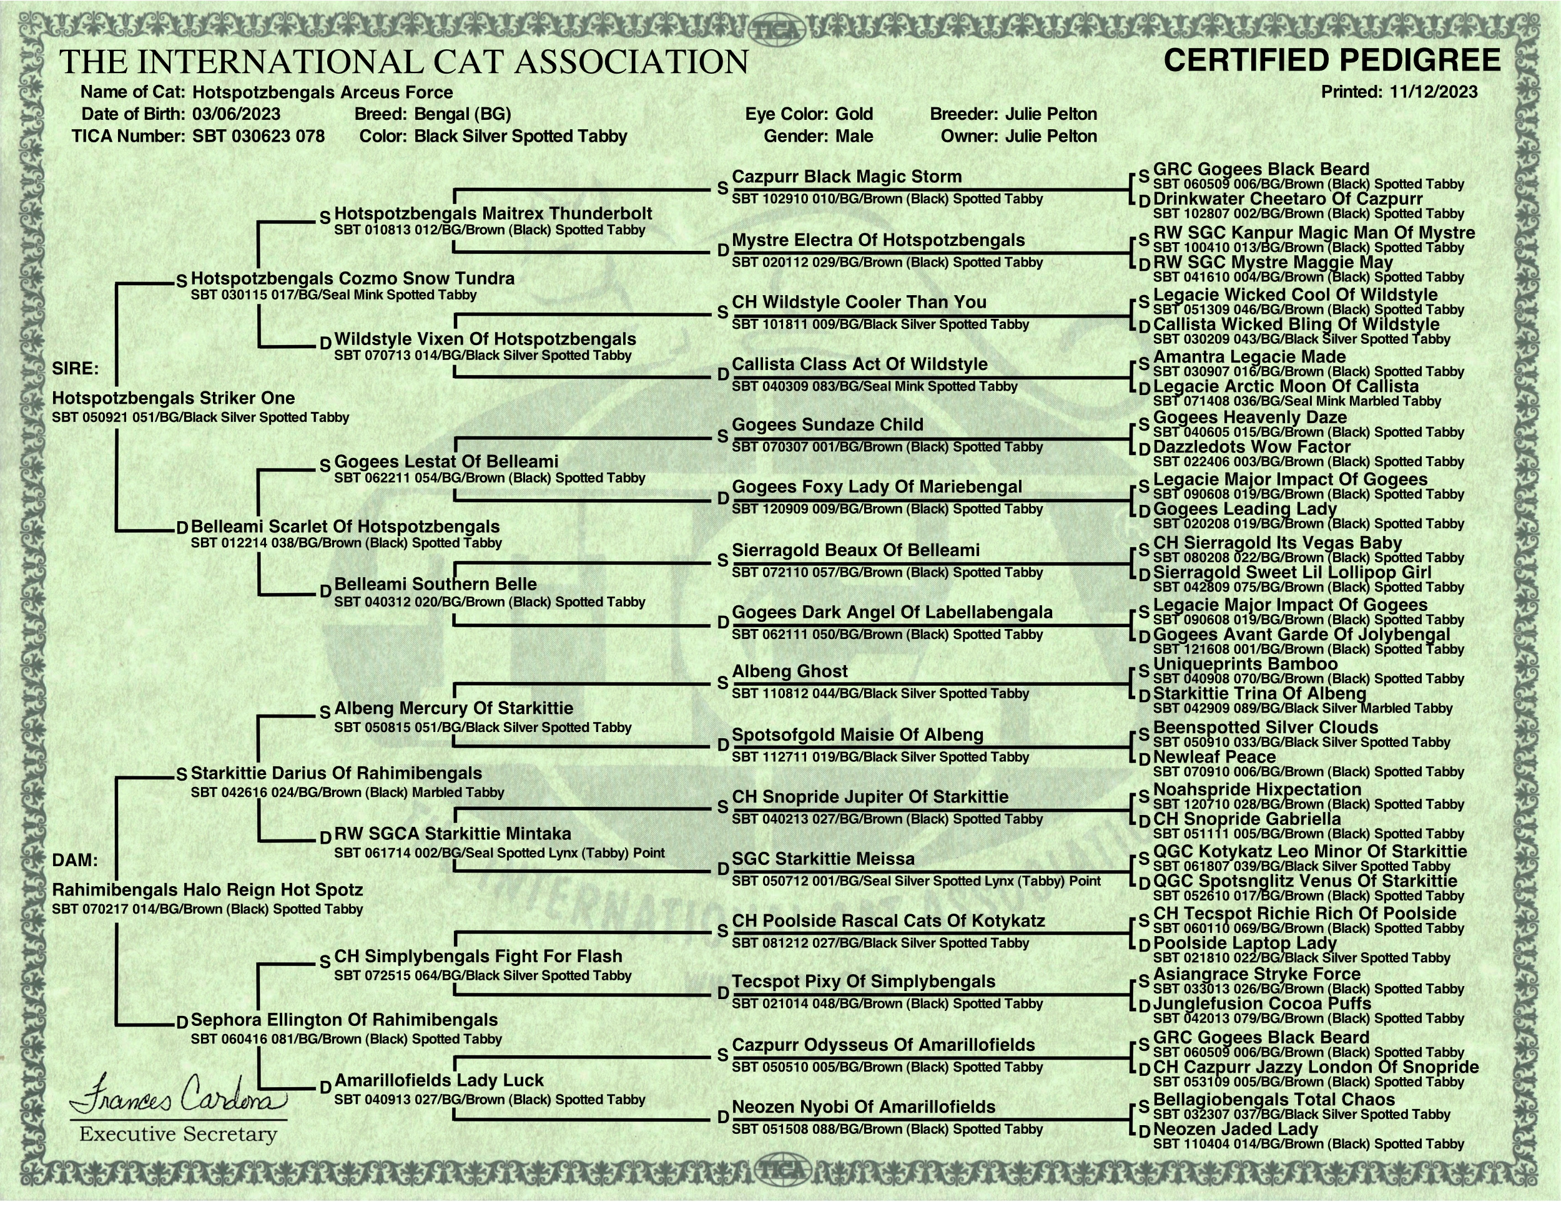
DO NOT COPY
PROPERTY OF:
© HOT SPOTZ BENGALS

